Slide 1
UNIT-III: Grammar- Reading skills and Professional Writing Skills.
Grammar:
Parts of speech
Usage of tense forms
Correction of sentences
Idioms and Phrases
Commonly Confused Words
Reading skills- Reading techniques-skimming, scanning, Types of Reading: Intensive and Extensive reading.
Writing skills- Paragraph writing,
Expansion of Ideas.
Letter writing-Drafting a Resume and Job application.
E-mail etiquette, Report writing.

Slide 2
PARTS OF SPEECH
1. Noun
2. Pronoun
3. Verb
4. Adverb
5. Adjective
6. Preposition
7. Conjunction
8. Interjection
PIVAN CAP

Slide 3
PARTS OF SPEECH
1. I applied for a bank loan.
2. Banks play an important role in a country.
3. You should not bank on your friends for help.

Slide 4
PARTS OF SPEECH
1. Nouns: A noun is a word used to name something: a person/animal, a place, a thing, or an idea.
Nouns are classified in several ways…
1. Nouns can be singular or plural.
2. Proper nouns
3. Common Nouns
4. Nouns can also be collective.
5. Nouns can also be either count or non-count.
6. Nouns can be Abstract or Concrete.

Slide 5
2. Pronouns: A pronoun is a word that replaces a noun. They eliminate the need for repetition. There are several types of pronouns.
1. Personal Pronouns: refer to specific persons or things. Personal pronouns can act as subjects, objects, or possessives.
Singular: I, me, (first person)/ you (Second person)
She, her, he, him, it (Third person)
Plural: we, us (First person)/ you (Second person)/
They, them (Third person)
I, you, she, he, it, we, and they are used as subjects of sentences.
For example: She knew the grammar rules very well.

Slide 6
The personal pronouns that can be used as objects are:
Me, you, him, her, it, them
2. Possessive Pronouns indicate ownership or possession.
Singular: my, mine, your, yours, hers, his, its
Plural: yours, ours, theirs,
For Example: She returned my pencil to me because it was mine.
3. Reflexive Pronouns name a receiver of an action who is identical to the doer of the action.
Singular: myself, yourself, himself, herself, itself
Plural: ourselves, yourselves, themselves
For example: Mansi congratulated herself on her good grades.
Here, Mansi is both the doer and the receiver of the action.
Q: So, who did Madhu congratulate? A: Herself.

Slide 7
4. Reciprocal Pronouns express shared actions or feelings.
They are: Each other, one another.
For Example:
Sahu and Shiva help each other with their homework.
Lenin and his girlfriend dance with one another when they go clubbing.

Slide 8
5. Demonstrative Pronouns are also considered noun markers. They "point" towards nouns.
this, that, these those.
For Example: That woman attends Gainesville College. That points out which woman.
The woman attends Gainesville College.
Q: Which woman? A: That woman.
6. Interrogative Pronouns introduce questions.
Who, Whom, Whose, Which, What
For Example:
Who is going on vacation? To whom will the teacher give an "A"?
What are you doing?

Slide 9
3. Verbs: Verbs generally express action or a state of being. There are several classifications for verbs- action verbs,/linking verbs, main verbs/auxiliary verbs, transitive/intransitive and phrasal verbs.
1. Action verbs show action.
He runs. He plays. They study.
2. Linking Verbs link the subject to an adjective.
Ricky Martin is beautiful.
The linking verb is links the adjective beautiful with the subject Ricky Martin.
1. Main verbs can stand alone.
2. Auxiliary verbs, also called helping verbs, serve as support to the main verb.

Slide 10
Verbs can be transitive or intransitive.
1. Transitive Verbs require a direct object in order to make sense. For Example:
Yolanda takes aspirin for her headaches. Here, takes is a transitive verb since the sentence Yolanda takes has no meaning without its direct object aspirin.
2. Intransitive Verbs do not need direct objects to make them meaningful.
For Example: Julio swims. The verb swim has meaning for the reader without an object.
For Example:
The cars race. – Here, race is intransitive. It does not need an object.
My father races horses. – Here, a race is transitive. It requires the object horses in order to make sense.

Slide 11
4. Adverbs: An adverb is a word that modifies an action verb, an adjective or another adverb.
Types of Adverbs:
1. Adverbs of manner describe the manner of an action done by the verb. They are happily, effectively etc.
They lived happily.
2. Relative Adverbs introduce questions and dependent adverbial clauses. They answer the questions When? and Where? They are: When Where When I was young, I liked to play outside.
Q: When did I like to play outside? A: When I was young.
3. Adverbs of Frequency indicate answer the question how often? They are: Always, usually, often, sometimes, rarely, never
The students in ESOL 98 always study very hard.
They rarely forget to do their homework.

Slide 12
4. Adverbs of place refers where the action done. They are here, there etc.
I went there.
Please come here.
5. Adverbs of time describe when the action is done. They are now, yesterday, soon etc.
She will come here soon.
They came yesterday.
6. Adverbs of degree describe how the action is done. They are how long, very etc.., soon etc.
How long will you stay in Bangalore?
He is very great.

Slide 13
5. Adjectives: An adjective modifies (describes) a noun or pronoun. Normally in English, the adjective comes before the noun.
I feel happy.
She is afraid.
Kinds of Adjectives:
1. Adjective of quality: An adjective is used to talk about the quality of the person or thing is known as adjective of quality.
For example: Wealthy, regional, industrial, fundamental, elementary, and primary.
Telugu is regional language.
2. Adjective of quantity: An adjective is used to talk about the quantity of things is known as adjective of quantity.
For example: little, much, enough, no, any, whole, all, great, half, sufficient.
There is a little milk in the jug.
My father earned enough money.

Slide 14
3. Adjective of number: An adjective is used to talk about the number of the things is known as adjective of quality.
For example: five, few, first, one.
Only few people are kind to the poor.
4. Demonstrative adjective: An adjective is used to point out the persons or things are known as Demonstrative adjective.
For example: This, that, these, those.
This book is very interesting.

Slide 15
6. Prepositions: Prepositions are words that, like conjunctions, connect a noun or pronoun to another word in a sentence. Some common prepositions:
1. Simple prepositions are as, to, of, by etc.
2. Double prepositions constitute two words they are out of, next to etc.
3. Compound prepositions are about, above, inside etc.
4. Phrase prepositions are in favour of, on account of, in order to, in addition to etc.
7. Conjunctions: They join together words and phrases. There are three kinds of conjunctions: coordinating conjunctions, correlative conjunctions, and subordinating conjunctions.
I like to have tea and coffee.
1. Coordinating Conjunctions There are seven coordinating conjunctions in English. You can use the mnemonic device fan boys to remember them.
For, And, Nor, But, Or, Yet, So,
Ignacio loves to dance, but Rocío has no rhythm.

Slide 16
2. Correlative Conjunctions also join ideas, but they do not work in pairs. They are:
Both…and, neither…nor, whether…or, either…or, not only…but also
Not only am I happy about the grades, but I am also excited that you are learning!
3. Subordinating Conjunctions join an independent clause to a subordinate clause. That is, they join a clause that can stand alone with a clause that cannot stand alone. Some frequently used subordinating conjunctions are:
After, although, as, as if, because, before, even if, even though, if, since, so that, though, unless, until, when, whenever, where, wherever, whether, while.
4. Compound/Combined Conjunctions also join ideas, but they work in pairs. They are: as well as, as soon as, so that etc.

Slide 17
8. Interjections:
Interjections are words used to express emotional states. They can usually be found in narrative writing, interviews, and in spoken English. They can stand alone.
For example:
Oh! Wow! Ouch! Oops! Hey!
Punctuation Note: They are punctuated with either commas or exclamation marks. Mild interjections are followed by a comma, but stronger interjections are punctuated with an exclamation mark (!).
Oh, we’re late for the movie.
Generally, the movie is not an important destination. Therefore, the person making this statement will sound less urgent than the next example.
Oh! I’m late for work.

Slide 18
Identify the parts of speech for the underlined words given in the paragraph below.
An engineer might interact with technology all day, but that doesn't mean he has no interaction with other people. He communicates with other engineers, with team members outside of engineering and often with customers as well. Within engineering, effective communication makes it possible to transform requirements into the best possible working or workable solutions. Outside of engineering, effective communication makes it possible to verify the team is working on all of the right requirements, and to ensure the resulting solution can, in fact, be implemented. While all engineers should have good communication skills, global engineers face additional challenges, making effective communication an imperative.

Slide 19
Answers
1.Engineer: Noun
2.Communicates: Verb
3.Often: Adverb
4.Effective: Adjective
5.Of: Preposition

Slide 20


Slide 21
USAGE OF TENSE FORMS

Slide 22
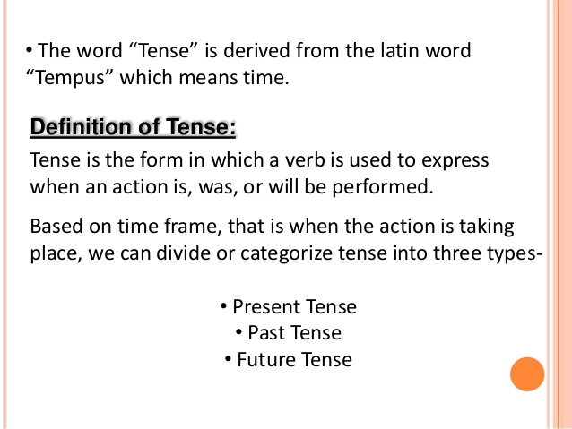


Slide 23
TYPES OF TENSES : 1. PRESENT TENSE:
1.1. Present simple (I DO) [Subject + Am/is + verb]
A. We use the present simple to talk about things in general. We are not thinking only about now. We use it to say that something happening, happens all the time or repeatedly, or that something is true in general. It is not important whether the action is happening at the time of speaking.
I usually go away at weekends.
The earth goes round the sun.

Slide 24
TYPES OF TENSES : 1. PRESENT TENSE:
1.1. Present simple (I DO) [Subject + Am/is + verb]
We use simple present to make affirmative and negative sentences.
Affirmative Sentences. Negative sentences
Subject | Verb | Complement
I/we/you/ they He/she/it | Don’t Doesn’t | Work. Come.
Subject | Verb | Complement
I We You | talk understand speak | English well.
He She It | reads writes imitates
They | Communicate

Slide 25
1.2. Present continuous (I am doing) [Subject + Am/is/are + verb+ ing]
A. Anna is in her car. She is on her way to work.
She is driving to work.
This means: She is driving now. At the time of speaking. The action is not finished.
B. I am doing something= I am in the middle of something. I have started doing it and haven’t finished yet.
Often the action is happening at the time of speaking.
Please don’t make so much noise. I am working. (not I work)
C. We use the present continuous when we talk about things happening in a period around now. (Today, this week, this evening)
You’re working hard today. Yes I have a lot to do. (not to work hard today)

Slide 26
1.2. Present continuous (I am doing) [Subject + Am/is/are + verb+ ing]
We use present continuous to make affirmative and negative sentences.
Affirmative sentences. Negative sentences.
S | HV | MV | Complement |  | S | HV | MV | Complement
I We You | am are are | speaking talking understanding | English well. |  | I We You | am are are | not speaking not talking not understanding | English well.
He She It | is is is | reading writing imitating |  |  | He She It | is is is | not reading not writing not imitating
They | are | Communicating |  |  | They | are | not communicating

Slide 27
1.3. Present perfect (I have done) [Subject + has/have + Past form of verb (V3)] :
We use the Present Perfect to say that an action happened at an unspecified time before now. The exact time is not important. You CANNOT use the Present Perfect with specific time expressions such as: yesterday, one year ago, last week, when I was a child, when I lived in Japan, at that moment, that day, one day, etc. We CAN use the Present Perfect with unspecific expressions such as: ever, never, once, many times, several times, before, so far, already, yet, etc.
Examples:
You have seen that movie many times.
You have not seen that movie many times.
Have you seen that movie many times?
We use the present perfect there is always connection with now. The action in the past has a result now.
Where is your key? I don’t know. I have lost it. (I haven’t got it now)
He told me his name but I have forgotten it. (I can’t remember it now)

Slide 28
1.3. Present perfect (I have done) [Subject + has/have + Past form of verb (V3)] :
S | HV | MV | Complement |  | S | HV | MV | Complement
I We You | have have have | spoken talked understood | English well. English well. |  | I We You | have have have | not spoken not Talked not understood | English well.
He She It | has has has | read written imitated |  |  | He She It | has has has | not read not written not imitated | English well.
They | have | communicated |  |  | They | Have | not communicated | English well.

Slide 29
1.4. Present perfect continuous: (I have been doing) [Subject + Has/have + been + ing]
We use the Present Perfect Continuous to show that something started in the past and has continued up until now. "For five minutes," "for two weeks," and "since Tuesday" are all durations which can be used with the Present Perfect Continuous.
Examples:
She has been working at that company for three years.
James has been teaching at the university since June.

Slide 30
1.4. Present perfect continuous: (I have been doing) [Subject + Has/have + been + ing]
S | HV | MV | Complement |  | S | HV | MV | Complement
I We You | have been | speaking talking understanding | English well. English well. |  | I We You | haven’t been haven’t been haven’t been | speaking talking understanding | English well. English well.
He She It | has been | reading writing imitating |  |  | He She It | hasn’t been | Reading writing imitating
They | have been | Communicating |  |  | They | haven’t been | Communicating

Slide 31
2. PAST TENSE: 2.1. Simple Past: [Subject + Past form of verb (V2)]
Use the Simple Past to express the idea that an action started and finished at a specific time in the past. Sometimes, the speaker may not actually mention the specific time, but they do have one specific time in mind.
Examples:
I saw a movie yesterday.
I didn't see a play yesterday.
We use simple past to make affirmative and negative sentences.
Affirmative sentences Negative sentences.
Subject | Verb | Complement |  | Subject | Verb |  | Complement
I We You | talked understood spoke | English well. |  | I/we/you/they He/she/it | Didn’t Didn’t | Work. Come.
He She It | read wrote imitated
They | communicated

Slide 32
2.2. Past Continuous: [Subject + was/were + verb + ing]
Use the Past Continuous to indicate that a longer action in the past was interrupted. The interruption is usually a shorter action in the Simple Past. Remember this can be a real interruption or just an interruption in time.
Examples:
You were studying when she called.
You were not studying when she called.
I was watching TV when she called.
When the phone rang, she was writing a letter.
We use past continuous to make affirmative and negative sentences.
Affirmative sentences. Negative sentences.
S | HV | MV | Complement |  | S | HV | MV | Complement
I We You | was were were | speaking talking understanding | English well. |  | I We You | was were were | not speaking not talking not understanding | English well.
He She It | was was was | Reading writing imitating |  |  | He She It | was was was | not reading not writing not imitating | English well.
They | Were | Communicating |  |  | They | were | not communicating | English well.

Slide 33
2.3.Past Perfect: [Subject + had + past form of verb (V3)]
The Past Perfect expresses the idea that something occurred before another action in the past. It can also show that something happened before a specific time in the past.
Examples:
You had studied English before you moved to New York.
Had you studied English before you moved to New York?
You had not studied English before you moved to New York.
We use past perfect to make affirmative, negative and interrogative sentences.
Affirmative sentences Negative sentences
S | HV | MV | Complement |  | S | HV | MV | Complement
I We You | had had had | spoken talked understood | English well. English well. |  | I We You | had had had | not spoken not talked not understood | English well.
He She It | had had had | read written imitated |  |  | He She It | had had had | not read not written not imitated | English well.
They | had | Communicated |  |  | They | had | not communicated | English well.

Slide 34
2.4. Past Perfect Continuous: [Subject + had been + ing]
We use the Past Perfect Continuous to show that something started in the past and continued up until another time in the past. "For five minutes" and "for two weeks" are both durations which can be used with the Past Perfect Continuous. Notice that this is related to the Present Perfect Continuous; however, the duration does not continue until now, it stops before something else in the past.
Examples:
You had been waiting there for more than two hours when she finally arrived.
You had not been waiting there for more than two hours when she finally arrived.
They had been talking for over an hour before Tony arrived.
We use past perfect continuous to make affirmative, negative sentences.
Affirmative sentences Negative sentences
S | HV | MV | Complement |  | S | HV | MV | Complement
I We You | had been | speaking talking understanding | English well. English well. |  | I We You | had not been | speaking talking understanding | English well.
He She It | had been | reading writing imitating |  |  | He She It | had not been | reading writing imitating | English well.
They | had been | communicating |  |  | They | had not been | Communicating

Slide 35
3. FUTURE TENSE:
3.1. Simple Future: [Subject + will/shall + present form of verb]
Examples:
You will help him later.
Will you help him later?
You will not help him later.
We make simple future
Affirmative and Negative sentences.
Subject | HV | Verb | Complement |  | Subject |  | Verb | Complement
I We You | shall shall will | talk understand speak | English well. |  | I/we/you/they He/she/it | Won’t Won’t |  | Work. Come.
He She It | will will will | read write imitate
They | will | communicate

Slide 36
3.2. Future Continuous: [Subject + will be/shall be + present form of verb + ing]
Examples:
You will be waiting for her when her plane arrives tonight.
You will not be waiting for her when her plane arrives tonight.
We use future continuous to make affirmative and negative sentences.
Affirmative sentences. Negative sentences.
S | HV | MV | Complement |  | S | HV | MV | Complement
I We You | Shall be Shall be Will be | speaking talking understanding | English well. |  | I We You | Shall not be Won’t be | speaking talking understanding | English well.
He She It | Will be | reading writing imitating |  |  | He She It | Won’t be | reading writing imitating
They | Will be | communicating |  |  | They | Won’t be | Communicating

Slide 37
3.3. Future Perfect: [Subject + will/shall have + past form of verb (V3)]
Examples:
You will have perfected your English by the time you come back from the U.S.
You will not have perfected your English by the time you come back from the U.S.
By next November, I will have received my promotion.
By the time he gets home, she is going to have cleaned the entire house.
I am not going to have finished this test by 3 o'clock.
We use future perfect to make affirmative, negative and interrogative sentences.
Affirmative sentences Negative sentences
S | HV | MV | Complement |  | S | HV | MV | Complement
I We You | will have | spoken talked understood | English well. English well. |  | I We You | will have | not spoken not talked not understood | English well.
He She It | will have | read wrote imitated |  |  | He She It | will have | not read not wrote not imitated | English well.
They | will have | communicated |  |  | They | will have | not communicated | English well.

Slide 38
4.4. Future Perfect Continuous: [Subject + will have been + present form of verb + ing]
Examples:
You will have been waiting for more than two hours when her plane finally arrives.
You will not have been waiting for more than two hours when her plane finally arrives.
We use future perfect continuous to make affirmative, negative sentences.
Transformation of tenses in affirmation, negative and interrogative sentences.
S | HV | MV | Complement |  | S | HV | MV | Complement
I We You | will have been | speaking talking understanding | English well. English well. |  | I We You | won’t have been | speaking talking understanding | English well. English well.
He She It | will have been | reading writing imitating |  |  | He She It | won’t have been | reading writing imitating
They | will have been | communicating |  |  | They | won’t have been | Communicating

Slide 39
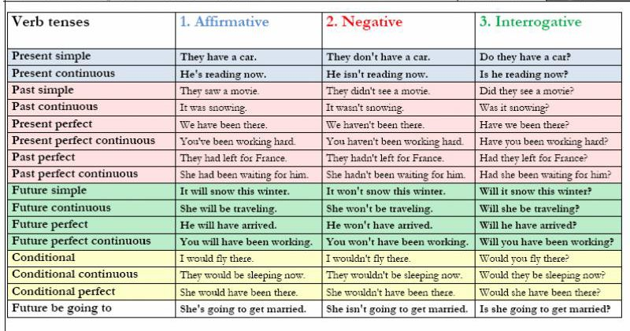

Slide 40
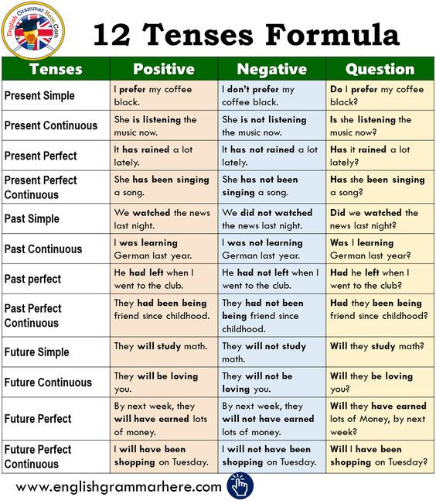

Slide 41
Identify the tense for the following sentences.
My cousin is leaving tomorrow. I have never seen him in a passive mood. I did not concentrate on my studies. The president will be talking to us tomorrow. I shall have finished my writing by then.

Slide 42
Answers
My cousin is leaving tomorrow. – Present Continuous Tense
I have never seen him in a passive mood. – Present perfect tense
I did not concentrate on my studies. – Simple Past Tense
The president will be talking to us tomorrow. – Future Continuous Tense
I shall have finished my writing by then. – Future Perfect Tense

Slide 43
Identify the tense in the given sentences.
I will be studying English when you arrive tonight.
2. I have studied English in several different countries.
3. I had studied a little English before I moved to the U.S
4. I will have studied every tense by the time I finish this course.
5. I had been studying English for five years before I moved to the U.S.
6. I will have been studying English for over two hours by the time you arrive.

Slide 44
Change the following sentences into other tenses as given in the brocket.
1. | She has chosen blue curtains for room. (into Past Perfect tense)
2. | She will go out for dinner this evening. (Future Continues tense)
3. | The helicopter will be landing at 6 am this morning. (into Simple Future tense)
4. | We knew about his plan. (into Simple Present tense)
5. | I haven’t got the keys to the stores. (into past perfect tense)
6. | I speak French. (into present continuous tense) Why are the kids sleeping? (into past continuous tense)
7. | We will eat in ten minutes. (into future continuous tense)
8. | He is studying to become a dentist. (into past continuous tense)

Slide 46
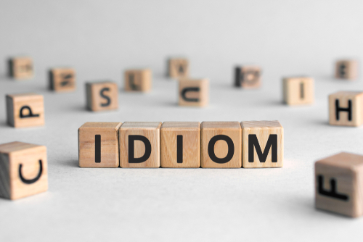

Slide 47
USAGE OF IDIOMS AND PHRASAL VERBS:
An idiom is an expression whose meaning is different from the meaning of its constituent words..
Once in a blue moon: If something happens once in a blue moon, it happens rarely.
Many startups turn in a profit once in a blue moon.
Phrasal verb:
A phrasal verb is a verb plus a preposition or adverb which creates a meaning different from the original verb.
Look after: take care of someone or something.

Slide 48
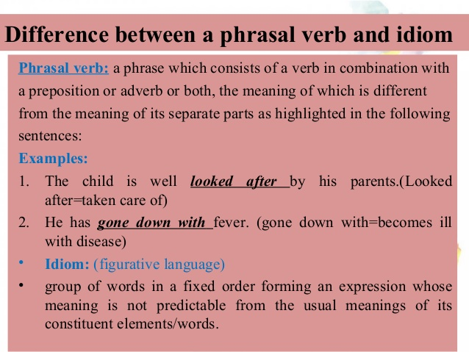

Slide 49
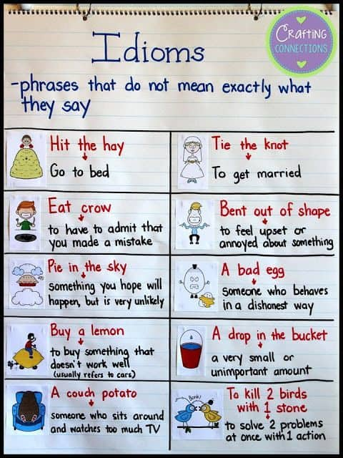

Slide 50
TURN OVER A NEW LEAF | Changing for the better
After Ajit was released from prison, he decided to turn over a new leaf and become an honest man.
HIT BELOW THE BELT | To act in an unfair manner
The candidate of the opposition party spread false rumors about the Minister. People felt that he was hitting below the belt.
GIFT OF THE GAB | The ability to speak well
Pooja was able to keep the audiences amused with her stories.
She surely has the gift of the gab.
FACE THE MUSIC | To face the consequences of one’s action
I lost my father’s pen. I will have to face the music when I reach home.

Slide 51
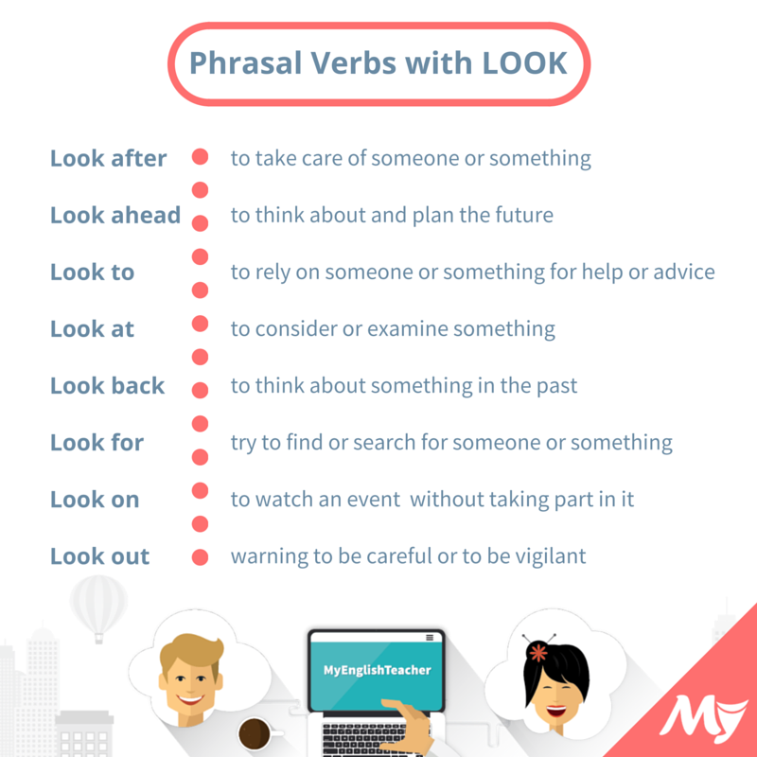

Slide 52
Give meaning and frame a sentence with the given idioms.
To smell a rat
Backstairs influence
Black and white
A black sheep
To pick holes
End in smoke
Bread and Butter
The apple of one’s eyes
Once in blue moon
Read between the lines

Slide 53


Slide 54
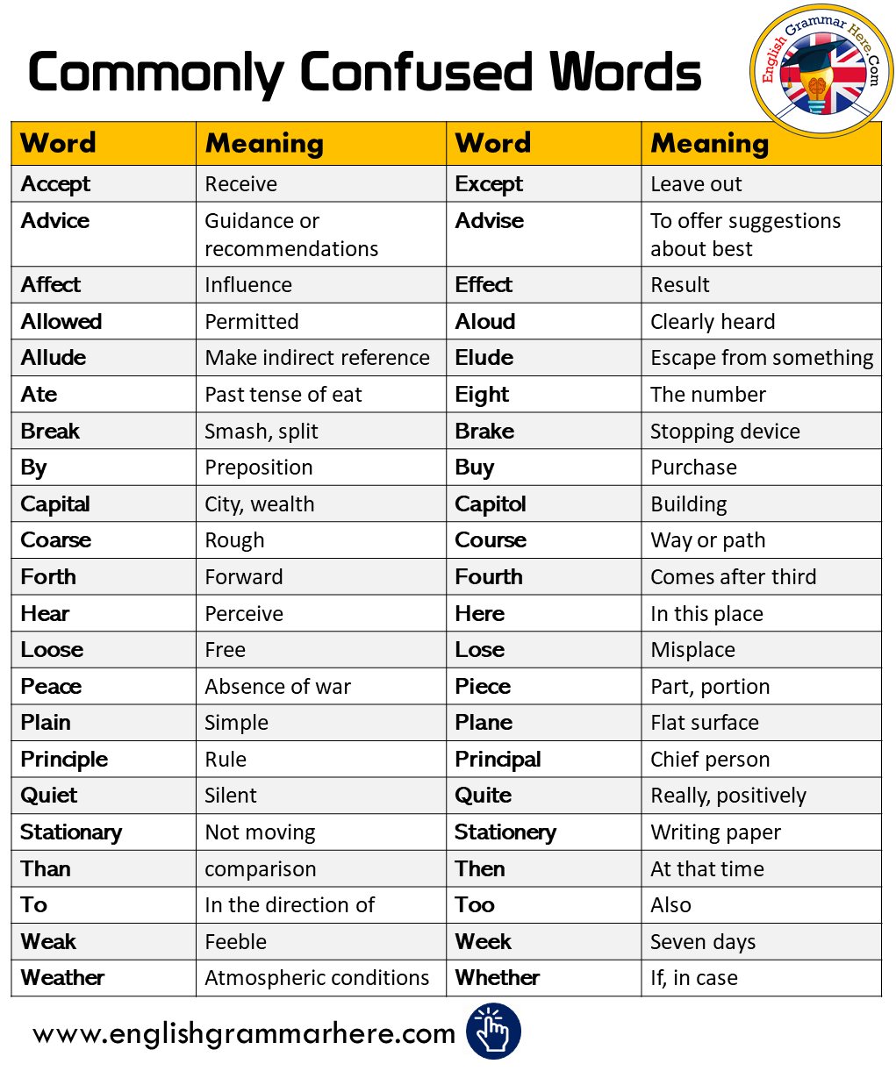

Slide 55
Fill the blanks with appropriate words from the bracket.
1. Everyone hates being ___________, for his or her mistakes. (Censure/censor)
2. By helping anyone who has committed a crime, we are indirectly being an _________ to the crime. (Accessary/ accessory)
3. The sentence of death passed on the two murders wasn’t ___________ right, according to me. (Quiet, quite)
4. It is believed that the __________ of Nero was one of our ever increasing populations. (Reign, rein)
5. If a person is ___________ then he or she will find it very difficult to cope with failures. (Objurgate/ obdurate)

Slide 56
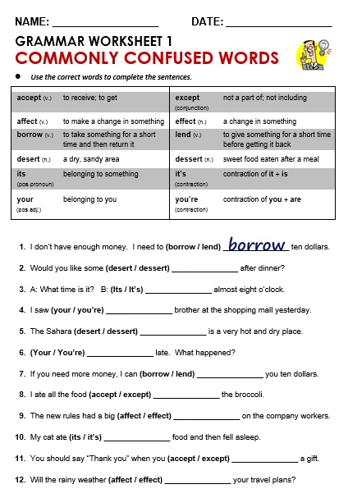

Slide 57
ERRORS IN SENTENCES:
English grammatical/language mistakes frequently found in Indian English.
1. Myself I am Suresh Babu. (x)
I am Suresh Babu. (√)
While introducing oneself, it is usually observed that the users mix up both the possessive pronoun 'myself' and the subject pronoun 'I'.
2. I am having four brothers and three sisters. (x)
I have four brothers and three sisters. (√)
Present Continuous Tense cannot be used for pragmatic situations such as this.
Simple Present Tense should be used.
3. He do not have a laptop. (x)
He does not have a laptop. (√)
Do not should not be used after the subject pronoun (He, She, It).
4 Does she has a car? (x)
Does she have a car? (√)
The helping verb does is used at the beginning of the sentence. The main verb have denotes possession or ownership.
5."Today office is there?" (x)
"No, office is not there. Today is Bharat Bandh." (x)
"Is today a working day?" OR "Are we working today?" (√)
"Yes, we are working today.” or “No, we are not working today." (√)

Slide 58
READING SKILLS

Slide 59
READING AND WRITING SKILLS
Reading techniques-Skimming, Scanning
Types of Reading-Intensive Reading, Extensive Reading
Reading different kinds of Texts

Slide 60
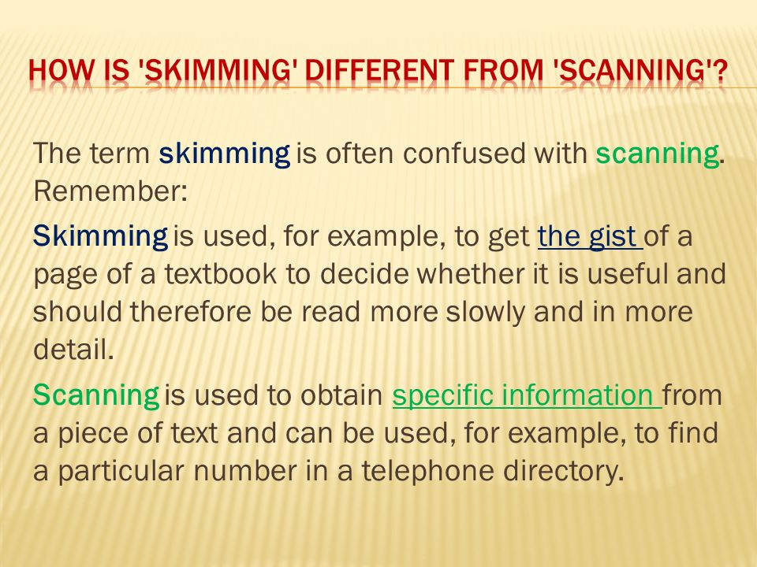
READING TECHNIQUES
1. Skimming:
Skimming of a lesson, means gathering together salient facts contained in it. Skimming of a prose, paragraph means going through it and collecting main points contained therein. Surely the reader is able to take out the best contained there in the lesson or the paragraph.
The practice of skimming is very important for the senior students. It gives them a lot of confidence. The main purpose of the person is to assemble main things contained therein.
EX: Reading Newspaper, Magazine.
2. Scanning:
Scanning of a book or a lesson or a paragraph means collecting detailed information contained in the subject matter. The reader goes through the subject matter with searching books. He/she examines everything very closely. So much that the reader is not allowed to ignore. Even a single difficult word contained therein. In scanning everything good or bad is pointed out. Everything objectively and in a very scientific manner is highlighted.
Ex: Google search list on the internet, reading to find your team's score.

Slide 61
TYPES OF READING
Intensive and extensive reading:
Intensive reading: If the purpose is to read a text in great detail or carefully intensive reading is required. Generally, textbooks called readers concentrate on intensive or detailed reading. Comprehensions, exercises on vocabulary, grammar, speaking and punctuation are set to make the student read the text carefully.
Ex: Reading notes for test preparation.
Extensive reading: On free reading for pleasure for interest in the subject matter or for the acquisition of information. It provides an encounter with language which is essential for the mastery of the language.
Ex: Reading novel for fun.

Slide 62
Reading different kinds of Texts:
1. Reading Entertaining Messages/Texts: Purpose of reading entertaining messages is to get relaxation. This is most common form of reading and it is causal as we are not paying attention about what we are reading.
Example: Reading short story, a gossip about film actress, novel jokes etc.
2. Reading General Messages/Texts: The main aim of reading general messages/ texts is to broad our outlook and widen our intellectual understanding and appreciation of things around us.
Example: Reading newspapers, magazine articles, encyclopedias etc.
3. Reading Reference Materials: The purpose of reading or scanning reference materials is to obtain specific information that might be used in a various academic and professional activities. It involves focused reading to quickly identify a specific piece of information. It requires effective scanning skills.
4. Reading business Documents: The reader must pay attention to all parts of the document. This kind of reading is interactive and productive, facilitating proper interaction and more effective reader-writer relationships.
Example: Business and project reports, letters, memos, e-mail messages, etc.,
5. Reading Scientific and Technical Texts: It is a complex and multifaceted process. We should try to understand not only linguistic patterns, but also discipline- specific information. Comprehension of linguistic and semantic patterns involves visual skills perceptual skills, vocabulary skill skimming skills, critical skills etc.

Slide 64
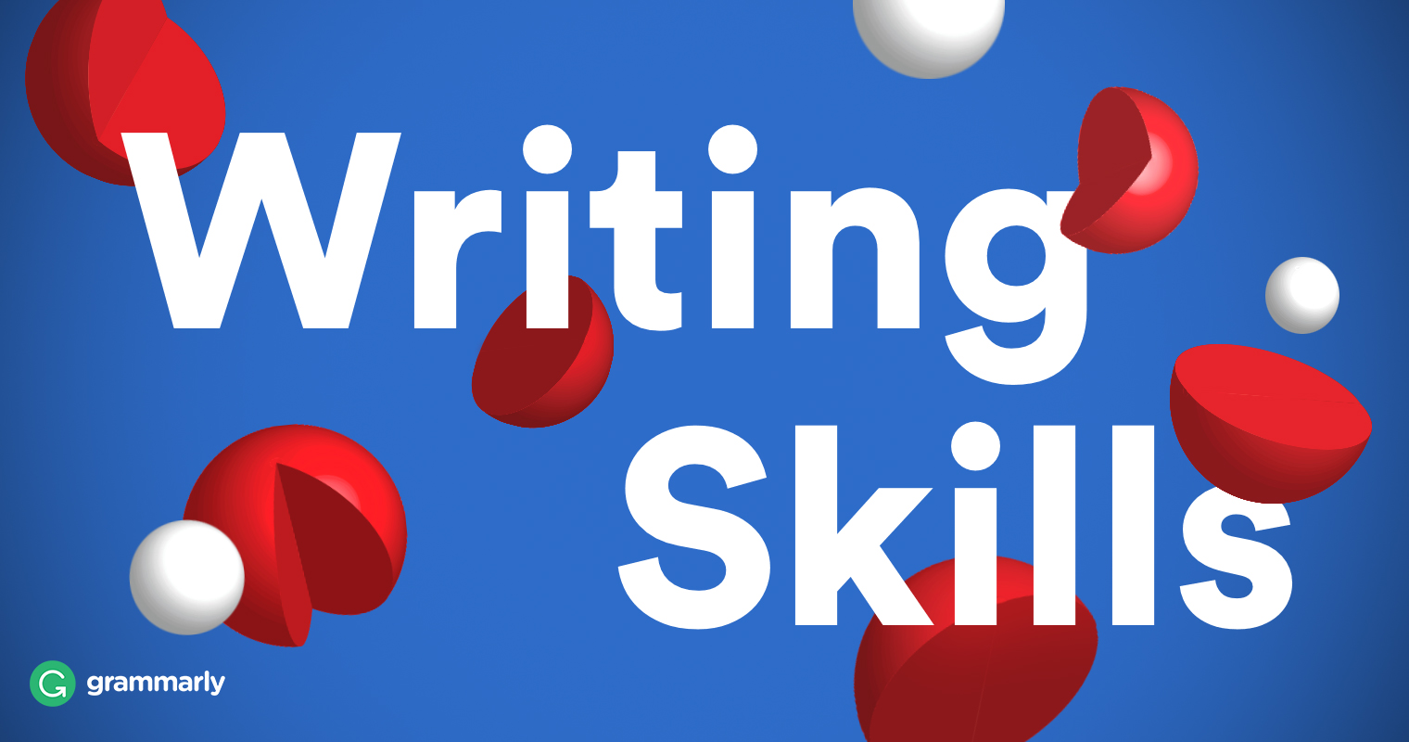

Slide 65
WRITING SKILLS
Professional writing strategies
Paragraph writing
Expansion of Idea
Letter writing
Resume, Job Application
Email Writing
Report Writing

Slide 66
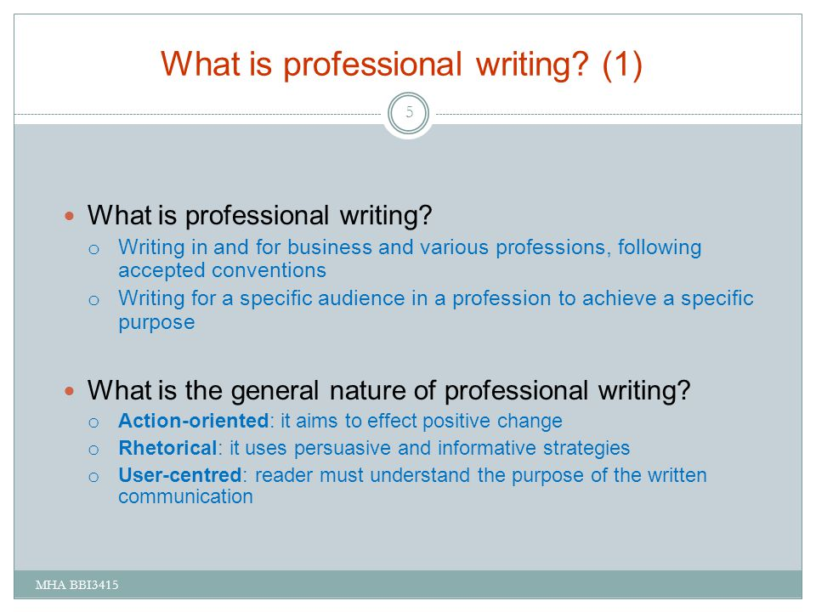

Slide 67
PROFESSIONAL WRITING STRATEGIES
Strategies for professional writing.
1. Overcoming writer’s block. There can be several reasons for this psychological condition. Writer’s block occurs when a writer stops generating new ideas because he/she starts feeling a loss of creative.
2. Measures to prevent a writer’s block
Think positive, Write for your pleasure. Overlook criticism. Do not sit at the writing table, Avoid distractions that waste a lot of time. Avoid excessive stress. Take short break in between.
3. Adding emphasis in writing.
Emphasis can be laid by changing the order of words in the sentence or by changing the voice of the sentence. A wrong positioning of words can change the meaning of sentence in ambiguity.
4. Accentuating the positives.
Every individual has a unique mixture of positive and negative traits.no one is perfect. Similarly people’s requirements also vary. It is very important to balance the positive and negative factors while conveying any message. Positive sentences are motivating more.
5. Avoiding plagiarism
Plagiarism is copying another person’s idea, words. Or work and pretending that they are own. It is considered that an intellectually dishonest and highly unprofessional act. Copyright violation is more of a legal offence enforced by the court.
6. Referencing and styling.
When preparing a technical document, writers would invariably be referring to several previous works while developing their ideas or building a base for their arguments.

Slide 68
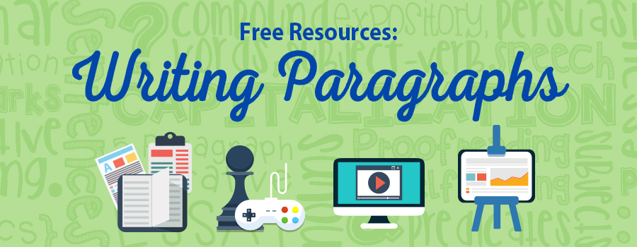

Slide 69
The Secrets to Good Paragraph Writing
Four Essential Elements
1. Unity
2. Order 3. Variety
4. Cohesion

Slide 70
How to write a paragraph?
I. Prewriting Paragraphs
Six Prewriting Steps:
1. Think carefully about what you are going to write.
2. Open your notebook.
3. Collect facts related to your paragraph or essay topic.
4. Write down your own ideas.
5. Find the main idea of your paragraph or essay.
6. Organize your facts and ideas in a way that develops your main idea.

Slide 71
II. Writing paragraphs
Five Writing Steps:
Open your notebook and word processor.
Write the topic sentence, supporting sentences, and closing sentence.
Write clear and simple sentences to express your meaning.
Focus on the main idea of your paragraph.
Use the dictionary to help you find additional words to express your ideas.

Slide 72
III. Editing Paragraphs
Grammar and Spelling
Style and Organization
IV. Parts of a Paragraph
Topic Sentence
Supporting Details
Closing Sentence

Slide 73
FORMAT OF PARAGRAPH WRITING
Topic:__________________________________ Introduction: Opening sentence about the topic should write. ------------------------------------------------------------------- Meaning and definition: Write meaning and definition of the topic.----------------------------- ------------------------------------------------------------------------------------------------------3. Explanation: 1. Write the topic sentence, supporting sentences, and closing sentence.____________________ 3. Write clear and simple sentences to express your meaning.____________________________ 4.Focus on the main idea of your paragraph._________________________________________ 5. Use proverbs, motto, and statements pertaining to the topic. ------------------------------------------------------------------------------------------------------------------------------ 4. Conclusion: -------------------------------------------------------------- 1.Write your own opinion and criticize about the related topic. 2. Write recommendations, suggestions, advise about the related topic. -------------------------------------------------------------------

Slide 74
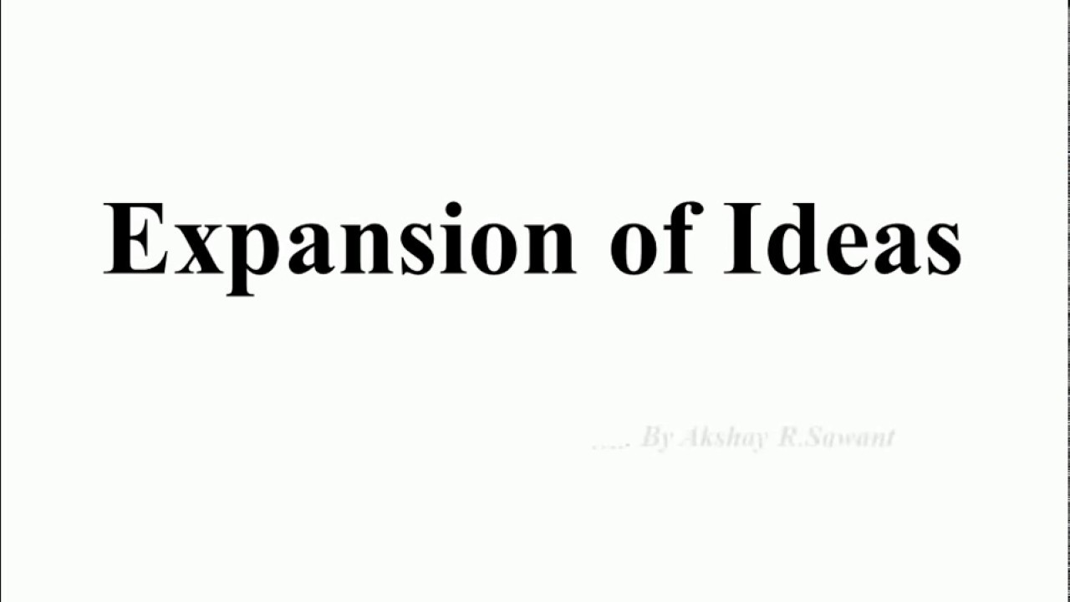

Slide 75
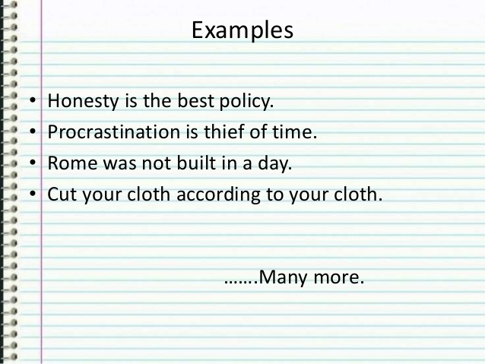

Slide 76
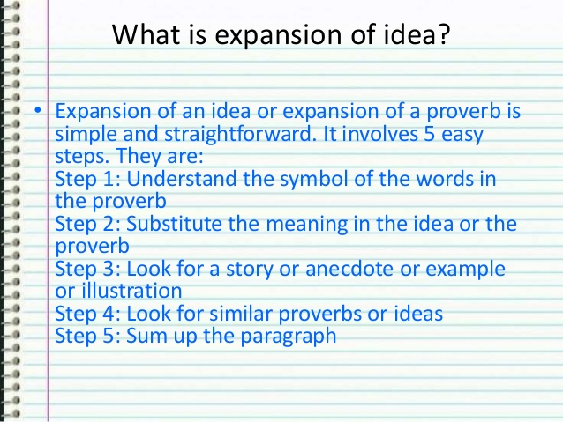
EXPANSION OF IDEAS
Steps of a Proverb Expansion or Expansion of an idea.
Expansion of an idea or expansion of a proverb is simple and straightforward. It involves 5 easy steps. They are:
Step 1: Understand the symbol of the words in the proverb: Most proverbs or ideas are symbolic. The name of place or animal or thing or person stands as a symbol of some quality. We have to try to understand that in the context of the proverb.
For example take the proverb, ‘Rome was not built in a day‘. Here the noun ‘Rome’ is the name of a place. We also (should) know that Rome was a great city. So what does Rome stand for? It stands for Greatness or success. (Remember it was a great city).
Or take the example of ‘All that glitters is not gold‘. Here we have the noun ‘gold’. It is the name of a thing. We know that gold is a precious metal. So what does gold stand for? It stands for precious.
Step 2: Substitute the meaning in the idea or the proverb: Take the two previous examples.
‘Rome was not built in a day’ and ‘All that glitters is not gold’. Now substitute the symbols we found out earlier in the sentences. What do we have?
‘Greatness or success was not built in a day.’
‘All that glitters is not precious.’
The proverb is now decoded and ready for understanding..

Slide 78


Slide 79
A letter is a written message that can be handwritten or printed on paper. It is usually sent to the recipient via mail or post in an envelope, although this is not a requirement as such. Any such message that is transferred via post is a letter, a written conversation between two parties.
Types of Letters
Formal Letter
Informal Letter
Business Letter
Official Letter
Social Letter:
Circular Letter:
Employment Letters

Slide 80
LETTER WRITING:
Drafting job Application letter and Resume
Rakesh Sharma MSR Nagar Bangalore. Rsharma@hotmail.com 20th Juner 2020. MrsMattyJenkyns HR Manager Manyatha Tech Park Bangalore. Respected Sir/Madam, Subject: Application for the post of Software Engineer. | Tries to find the name of the appropriate person to write to if possible.
I am looking for a placement within a software industry. I am writing to you as I understand that IBM may have appropriate vacancies available. I have a strong interest in software programming which I understand are predominantly carried out at this company. As I live only 5 miles from your site, travel and accommodation would not be a problem for me. | States the job she's applying for. States when she's available to start and end the placement.
I first became interested in the software programming from my college days learning. Since then, discussion with my careers adviser has confirmed my decision to aim for a career in this field. | Says why she's interested in the type of work.
Through my degree course, I achieved 68% in my final year examinations. During my college studies, I have also been able to utilize my skills in working with people through a variety of vacation jobs. | Summarises her strengths and how they might be an advantage to the organisation. Relates her skills to the job.
I would be most grateful if you could consider me for any suitable positions. I will be available for interview at any time and am at my home address in Bangalore from late December onwards. Please find enclosed my CV where you will find further information. Yours sincerely Rakesh Sharma (Signature) Enclosures: 1.Resume 2.Marks cards | Mentions dates she would be available for interview. Thanks the employer and mentions an enclosed CV.

Slide 81


Slide 82
The major difference between Bio-data, curriculum vitae (CV), and Resume:
Bio-data is short form of biographical data. It implies a shortened version of the autobiography.
It follows a chronological order, it starts with the first thing that is, name, father’s name, date of birth, and so on.
Past information is collected to predict future performance.
The bio-data includes physical attributes such as age, height, weight, even in some cases, the colour of hair, skin, and eye.
It is combined with the latest passport size photograph of the candidate. The usage of Bio-data functionally originates from the British and is practiced commonly in India.

Slide 83
Curriculum vitae: CV is short form of curriculum vitae, a Latin phrase, which means “the course of life.”
It is taken to mean one’s career graph or career progress.
The focus here is more on the career.
It is an overview of a person’s experience and other qualifications.
It is a long synoptic account of the candidate’s professional experience, qualifications, and some personal information.
Although some personal information is added, the larger perspective is on career progress.
The emphasis of the information changes according to the particular position applied.
Résumé: Resume is typically American, in which, personal, family, social, and religious backgrounds are ignored.
Résumé, meaning summary in French, is a short descriptive account of one’s academic and work history.
The life details are very minimal, almost nothing in this.
Résumé is a document containing a focused sketch of relevant job experience and education.

Slide 84
RESUME/ CURRICULUM VITAE (CV)
Name:
Address:
E-Mail Id:
Contact No.:
---------------------------------------------------------------------------------------------------------------------
Career Statement: Looking for challenging and responsible opportunity, explore strength and potentials in a professional organizations to meet employers expectations.
---------------------------------------------------------------------------------------------------------------------
Academic Profile:
Project Experience:
Currently working on XYZ project for ABC company ltd., using VB and SQL.
Implemented ABC system at XYZ client using C++.
Computer skills:
Programming in C/ C++
Well Verse with VB 6.0, Oracle and MS Access
Achievements:
Obtained scholarship of “amount” from XYZ Group of Industries in “year”
Ranked “A” in S.S.C. merit list
Extracurricular activities:
Lead the college tech-fest – “name”
Personal Details:
Date of Birth:
Sex:
Marital status:
Nationality:
Languages known:
Hobbies:
References:
1] Name, Designation and Address: 2] Name, Designation and Address:
------------------------------------------- ---------------------------------------
Year of Passing | Qualification | Board/University | Percentage
1998 | High school | SSLC | 86%
2000 | Higher Secondary (PUC) | PU Board, Bangalore. | 78%
2003 | Bachelor of Degree | Bangalore University | 68%

Slide 85
Impressive Resume format
Attractive Paper
Well Printed Paper
Use Consistency
Perfect spacing
Length
Format
Avoid some points

Slide 86
EMAIL ETIQUETTE

Slide 87
INTRODUCTION
Meaning: Email stands for electronic mail. It is the easiest and the cheapest way of communication. It is used in formal, semi-formal as well as an informal way of expressions or writing.
Email communication offers more advantages; it’s inexpensive and saves papers and promotes green initiatives. It is convenient and saves time.

Slide 88
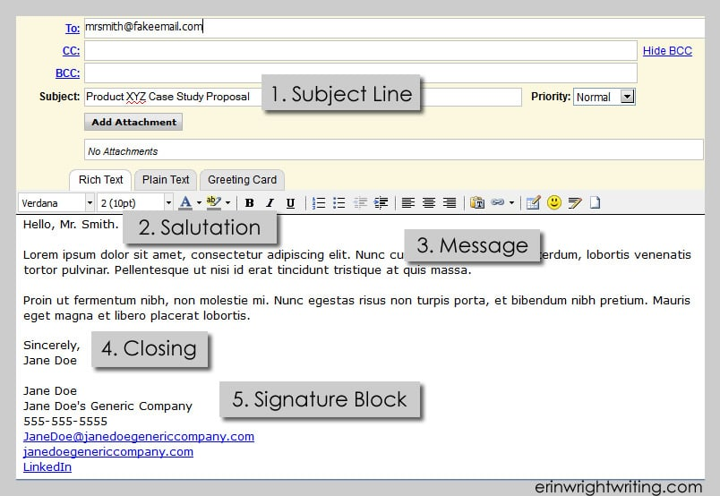
EMAIL FORMAT

Slide 89
EMAIL JARGON
Spam: Unsolicited email sent to many people simultaneously, usually commercial, but occasionally political.
Bounce: A message that was returned to the sender, either because the email address was incorrect, the receiver’s mailbox was full, or because there was a configuration problem on the receiver’s end.
Bot: A piece of software that acts on behalf of and in place of a remote human (from ro BOT).
Mailbot: A piece of software that automatically replies to email.
Listbot: A piece of software that manages distribution lists. Also called a list server or majordomo (after the name of a common list server
Post: Send to a distribution list or Usenet newsgroup, i.e., to a quasi-stable group of people.
Lurk: To read messages anonymously (in either a mailing list or Usenet newsgroup) without posting.
Ping: Test to see if the other person is there/awake/available. (This comes from a Unix test to see if a machine, or its net connection, was active or not.) ‘Lunch tomorrow? I may be busy with a client. Ping me at eleven thirty or so.’

Slide 90
Write an email for Inviting to your parents for college fest which will be held on January 21st 2021.
To: dennispeter@gmail.com
Cc:
Bcc:
Subject: Invitation.
Dear Parents,
Hope you all are well.
I am very glad to invite you for the Annual college fest-2021 which is going to be held on January 21st 2021 in our college. It’s been really long since caught up, so I think its great occasion to have lots of fun and love.
The annual college fest will be so grand and it showcases our talent as well, please be with us and encourage.
Hope to hear from you soon.
Best regards
XYZ

Slide 91
REPORT WRITING
A report is a formal document written for a specific audience to meet a specific need. It may contains facts of a situation, project or process: an analysis and interpretation of data, events and records, inferences or conclusions drawn from objective data or suggestions and recommendations.
Purposes of report waiting are:
Presenting data.
Describing and analyzing data.
Discussing and analyzing data.
Recording events and happenings.
Analyzing a situation or a condition.
Giving feedback, suggestions or recommendations.

Slide 92
Characteristics of Report writing
1. Precision
2. Accuracy of Facts
3. Relevancy
4. Reader-Orientation
5. Direct Language
6. Compactness
7. Syntactic Accuracy
8. Fair Recommendation
9. Clearness
10. Appealing Presentation

Slide 93
FORMATS OF REPORT WRITING The choice of format can be made according to the nature, length, scope, and function and type of audience.
SL.NO | Format | Description
1 | Printed format | Forms prepared to record for repetitive and routine data.
2 | Letter format | Short informal reports to be communicated to someone outside an organization.
3 | Memo format | Short informal reports to be communicated to someone within an organization.
4 | Manuscript | Formal reports printed on plain paper.

Slide 94
TYPES OF REPORTS
1. Event Reports
2. Project Reports
3. Book Reports
4. Meeting Reports
5. Scientific Reports
6. Technical Reports

Slide 95
1. Event Report: As the name suggests report on an event such as College Day, Dance program, and Independence Day function or Sports event is called ‘Event Report’.
The Event Report should follow this pattern.
1. Introduction: The introduction tells the reader what the program was, it's a date, where it was held and often the names of the main participants, etc. 2. Body of the Report: Which describes the entire event in the right sequence the body of a report briefly describes every item of the event in the order in which that took place each of the items may be described who are evaluated in a sentence. 3. Conclusion: The conclusion of a report should make a final statement about an event.

Slide 96
2. Project Report: The project report is more Complex than an event report. It is a subject matter that usually has greater significance and a more detailed layout.
Parts of a Project Report
Title page
Foreword
Abstract or Summary
Contents
Introduction
Body of the Report
Conclusion
Recommendations
Bibliography
Glossary
Index
Illustrations

Slide 97
3. Book Report: A book report should have an introduction, a body and a conclusion.
Introduction: The first paragraph should introduce the whole report. It must give information about the title, the author, the year of publication, a brief description of the setting of the story.
Body of the book report: is the heart of the report. It introduces all the main characters, describes the conflict in the story and finally talks of how the conflict is resolved. This part of the report the way it is written is critical to the value of the whole report.
Conclusion: The concluding paragraph reveals the reader’s own evaluation or personal opinion of the book. It must also identify the strengths and weaknesses of the book.

Slide 99
?

